Slide 1
Introduction to
Parallel Computing
Dr. Joachim Mai
Aug 2013

Slide 2
Content
Introduction
Motivation: Why Parallel Programming
Memory architectures (shared memory, distributed memory)
Available Hardware
Programming Models
Designing Parallel Programs
Costs of Parallel Programs
OpenMP
Intro to OpenMP with examples and exercises
MPI
Intro to MPI with examples and exercises

Slide 3

Why use Parallel Computing
The Universe is parallel
Parallel computing is just the next step of serial computing to describe systems which are intrinsically parallel.

Slide 4
Parallel Computing
From Top500 (June 2010):
Name | Institute | No of cores
Jaguar | Oak Ridge | 224,162
Nebulae | China | 120,640
Roadrunner | DOE | 122,400
Kraken | Comp. Sci. | 98,928
Massive parallel machines

Slide 5
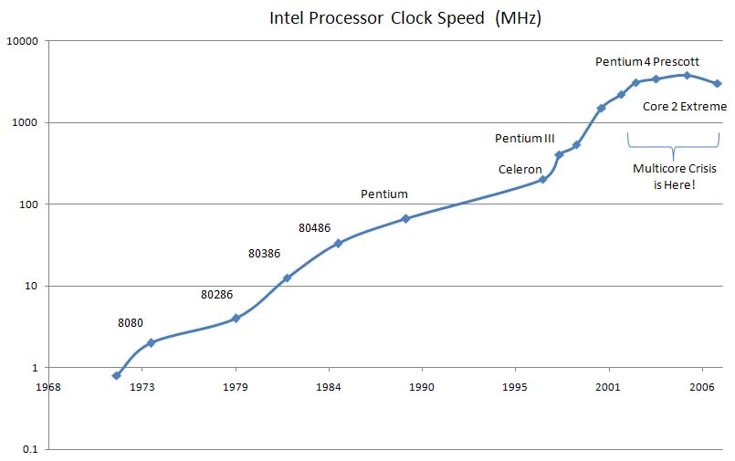
Clock Speed
Almost no frequency increase since 2000!

Slide 6

Uses for Parallel Computing
Scientific uses:
Quantum Chemistry
Solid State Physics
Earth Sciences
Mechanical Engineering
Many more

Slide 7

Uses for Parallel Computing
Commercial uses:
Data mining
Financial modeling
Pharmaceutical design
Oil exploration
Many more

Slide 8
What can Parallel Computing do?
Solve larger problems (Grand Challenges)
Use non-local resources (Seti@Home)
Solve problems quicker (Weather forecast)
Save money (Stock transactions)
Etc.

Slide 9
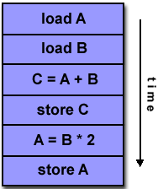
Flynn's Classical Taxonomy
1) SISD: Single Instruction, Single Data
A serial (non parallel computer)
Only one instruction is used on a single data stream.

Slide 10
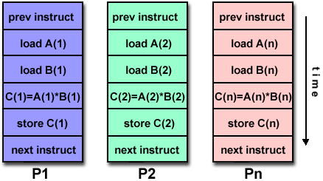

Flynn's Classical Taxonomy
2) SIMD: Single Instruction, Multiple Data
One instruction is used on several data.

Slide 11
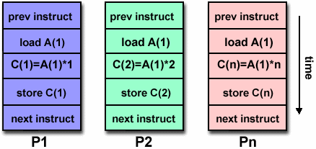
Flynn's Classical Taxonomy
3) MISD: Multiple Instructions, Single Data
Several instructions are used on a single data stream.
Only few computer ever existed.

Slide 12
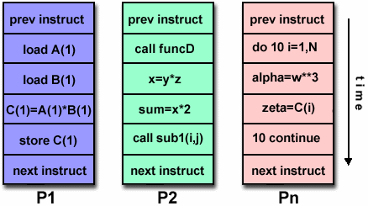
Flynn's Classical Taxonomy
4) MIMD: Multiple Instructions, Multiple Data
Every processor might use different instructions on different data sets.

Slide 13
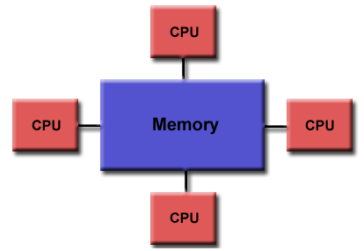
Memory Architectures
Shared memory architecture:
Uniform Memory Access (UMA)
Sometimes ccUMA (cache coherent)

Slide 14
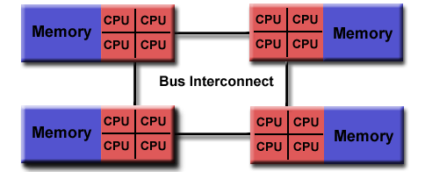
Memory Architectures
Shared memory architecture:
Non-Uniform Memory Access (NUMA)
Sometimes ccNUMA (cache coherent)

Slide 15
Memory Architectures
Advantages of Shared Memory:
Global address space (user friendly)
Fast data sharing
Disadvantages:
Lack of scalability (geometrical increase of traffic)
Cost

Slide 16
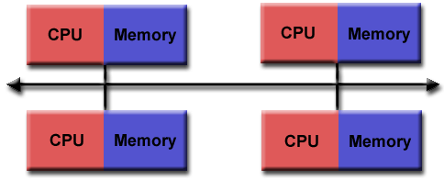
Memory Architectures
Distributed memory architecture:
Processors have their own local memory
Programmers have to ensure that each processors has the necessary data in the local memory
Each processor operates independently
Cache Coherency does not apply

Slide 17
Memory Architectures
Advantages of Distributed Memory:
Memory and processors are scalable
Cost (commodity hardware)
Disadvantages:
Programmer is responsible for data exchange and communication

Slide 18
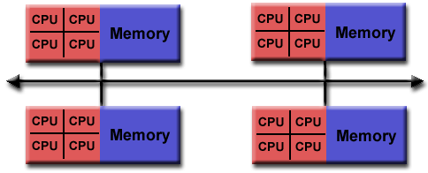
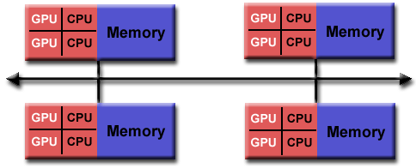
Memory Architectures
Hybrid memory architecture:
Largest computers use hybrid architectures

Slide 19
Available machines: Orange
SGI Cluster
Distributed memory
1,600 Sandy Bridge CPUs (cores)
64 – 256GB mem per node (100 nodes)
SUSE Linux

Slide 20
Available machines: Raijin
Fujitsu Cluster
Distributed memory machine
57,000 Sandy Bridge CPUs (cores,own 4%)
160 TB RAM
Centos Linux
At NCI/Canberra

Slide 21
Available machines: Octane
Training machine
SGI Cluster in a box
Distributed memory machine
4 x 8 Nehalem CPUs (cores)
24GB memory per node
Suse Linux

Slide 22
Parallel Programming Models
Shared Memory (without threads, native compilers)
Threads (Posix Threads and OpenMP)
Distributed Memory / Message Passing
Data Parallel
Hybrid
Single Program Multiple Data
Multiple Program Multiple Data

Slide 23
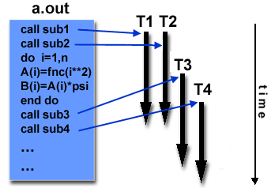
Threads Model
Type of shared memory model
Implementations: POSIX (C only) and OpenMP

Slide 24
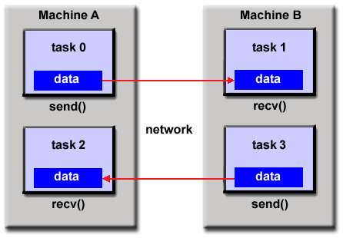
Message Passing Model
Type of distributed memory model
Implementations: Message Passing Interface MPI

Slide 25
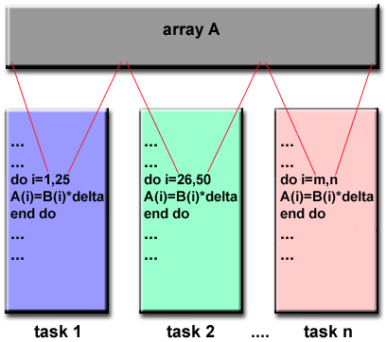
Data Parallel Model
Implementations: Fortran 90 and 95 - Fortran 77 plus pointers, dynamic memory allocation, array processing as objects, recursive functions, etc.
High Performance Fortran (HPF) - Fortran 90 plus directives to tell the compiler how to distribute data etc.

Slide 26
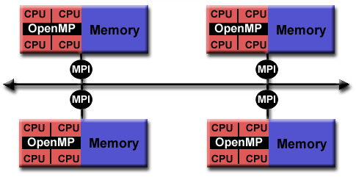
Hybrid Model
Message Passing (MPI) plus Threads (OpenMP)

Slide 27
Designing Parallel Programs
Determine whether the problem can be parallelized
F(n)=F(n-1)+F(n-2) Fibonacci non-parallelizable
Identify hotspots
Identify bottlenecks
Identify data dependencies (as F(n))
Investigate other algorithms

Slide 28
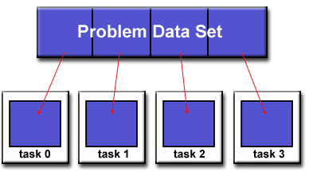
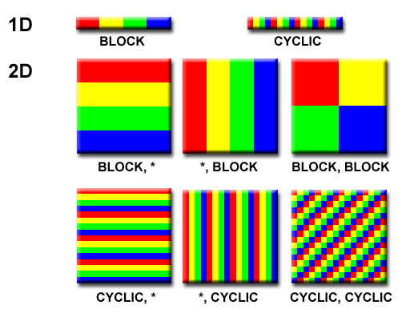
Designing Parallel Programs
Partitioning: Domain

Slide 29
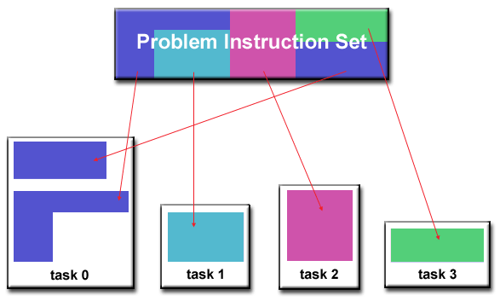
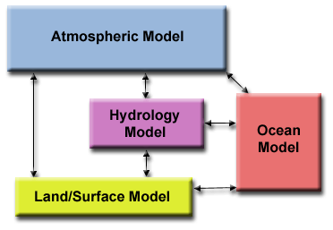
Designing Parallel Programs
Partitioning: Functional

Slide 30
Designing Parallel Programs
Communication:
Most parallel programs need communication (embarrassingly parallel programs do not)
Consider:
Latency: time it takes to send a 0 byte message from A to B
Bandwidth: amount of data that can be send in a unit time

Slide 31
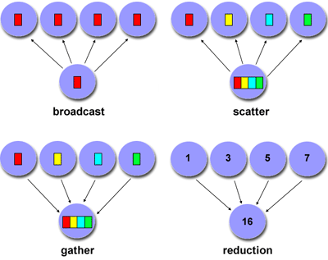
Designing Parallel Programs
Scope of Communication:

Slide 32
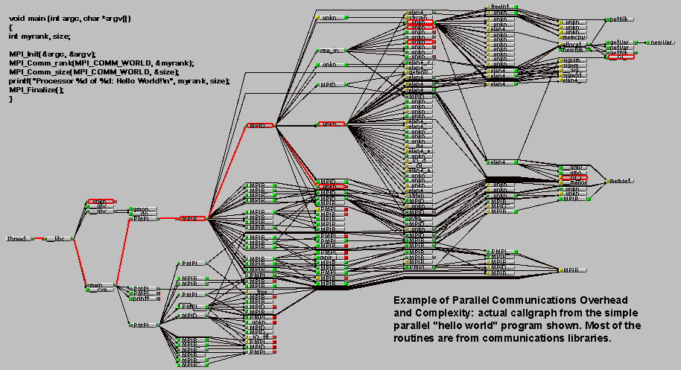
Designing Parallel Programs
Overhead and Complexity:

Slide 33
Designing Parallel Programs
Granularity:
Fine Grain Parallelism
Low computation/communication ratio
Good load balancing
Coarse Grain Parallelism
High computation/communication ratio
More difficult load balancing

Slide 34
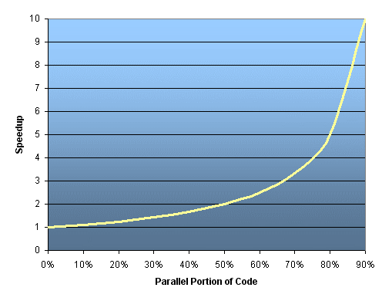
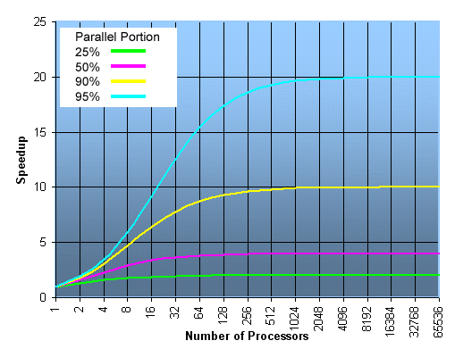
Designing Parallel Programs
Limits and Costs: Amdahl's Law
Speedup = 1/(1-p)

Slide 35
Designing Parallel Programs
Many more points to consider:
Complexity
Portability
Resource Requirements
Scalability
Etc.

Slide 36
OpenMP
OpenMP runs on a shared memory architecture.
With special programs such as ScaleMP also on a distributed memory architecture.
Application Programming Interface (API).
Not a new language.
It has bindings to C/C++ and Fortran.

Slide 37
OpenMP
Three primary API components:
- Compiler directives
- Runtime library routines
- Environment Variables
OpenMP Strong Points:
-Incremental Parallelization
-Portability
-Ease of use
-Standardized

Slide 38
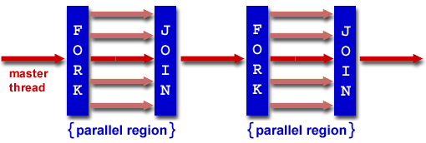
OpenMP
Program Flow:
- Thread based
- Fork-Join Model
- Compiler Directive based
- Dynamic threads

Slide 39
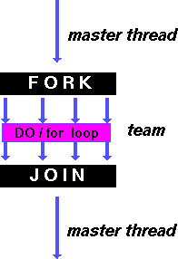
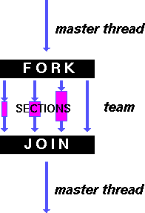
Work-Sharing Constructs

Slide 40
OpenMP
Compiler Directives:
- Fortran: !$OMP (or C$OMP or $OMP)
- C/C++: #pragma omp
Parallel Regions:
double A[1000];
omp_set_num_threads (4);
#pragma omp_parallel
{
int ID = omp_get_thread_num();
foo (ID, A);
}
printf (“Done\n”);

Slide 41
Parallel Region Construct
#pragma omp parallel [clause ...] newline
if (scalar_expression)
private (list)
shared (list)
default (shared | none)
firstprivate (list)
reduction (operator: list)
copyin (list)
num_threads (integer-expression)
structured_block
!$OMP PARALLEL [clause ...]
IF (scalar_logical_expression)
PRIVATE (list)
SHARED (list)
DEFAULT (PRIVATE | FIRSTPRIVATE | SHARED | NONE)
FIRSTPRIVATE (list)
REDUCTION (operator: list)
COPYIN (list)
NUM_THREADS (scalar-integer-expression)
block
!$OMP END PARALLEL

Slide 42
Parallel Region: Hello World: C
#include <omp.h>
main () {
int nthreads, tid;
/* Fork a team of threads with each thread having a private tid variable */
#pragma omp parallel private(tid)
{
/* Obtain and print thread id */
tid = omp_get_thread_num();
printf("Hello World from thread = %d\n", tid);
/* Only master thread does this */
if (tid == 0)
{
nthreads = omp_get_num_threads();
printf("Number of threads = %d\n", nthreads);
}
} /* All threads join master thread and terminate */
}

Slide 43
Parallel Region: Hello World: F
PROGRAM HELLO
INTEGER NTHREADS, TID, OMP_GET_NUM_THREADS,
+ OMP_GET_THREAD_NUM
C Fork a team of threads with each thread having a private TID variable
!$OMP PARALLEL PRIVATE(TID)
C Obtain and print thread id
TID = OMP_GET_THREAD_NUM()
PRINT *, 'Hello World from thread = ', TID
C Only master thread does this
IF (TID .EQ. 0) THEN
NTHREADS = OMP_GET_NUM_THREADS()
PRINT *, 'Number of threads = ', NTHREADS
END IF
C All threads join master thread and disband
!$OMP END PARALLEL
END

Slide 44
Environment Setup: Modules
Almost no defaults are set. Choose which compiler or program version you want to use.
Commands:
module avail
module list
module show
module load name
module unload name
Use this for your batch scripts as well!

Slide 45
Compiling Code
ssh hpc01@octane.intersect.org.au
module load intel-tools-13/13.0.1.117
Intel: icc test.c -o test -openmp
ifort test.f -o test -openmp

Slide 46
Exercise 1: Hello World
Write a hello-world program in C or Fortran. Observe the order of the ranks. Get a feeling to work with the modules.
Hints:
Load the Intel compilers:
module load intel-tools-13/13.0.1.117
Compile:
icc hello.c -o hello -openmp
ifort hello.f -o hello -openmp
Set environment:
export OMP_NUM_THREADS=4
Run:
./hello

Slide 47
For/Do Directive: C
#pragma omp for [clause ...] newline
schedule (type [,chunk])
ordered
private (list)
firstprivate (list)
lastprivate (list)
shared (list)
reduction (operator: list)
collapse (n)
nowait
for_loop

Slide 48
For/Do Directive: Fortran
!$OMP DO [clause ...]
SCHEDULE (type [,chunk])
ORDERED
PRIVATE (list)
FIRSTPRIVATE (list)
LASTPRIVATE (list)
SHARED (list)
REDUCTION (operator | intrinsic : list)
COLLAPSE (n)
do_loop
!$OMP END DO [ NOWAIT ]

Slide 49
Clauses
SCHEDULE: Describes how iterations of the loop are divided among the threads in the team.
STATIC
Loop iterations are divided into pieces of size chunk and then statically assigned to threads. If chunk is not specified, the iterations are evenly (if possible) divided contiguously among the threads.
DYNAMIC
Loop iterations are divided into pieces of size chunk, and dynamically scheduled among the threads; when a thread finishes one chunk, it is dynamically assigned another. The default chunk size is 1.
GUIDED
Iterations are dynamically assigned to threads in blocks as threads request them until no blocks remain to be assigned. Similar to DYNAMIC except that the block size decreases each time a parcel of work is given to a thread.

Slide 50
Clauses
RUNTIME
The scheduling decision is deferred until runtime by the environment variable OMP_SCHEDULE. It is illegal to specify a chunk size for this clause.
AUTO
The scheduling decision is delegated to the compiler and/or runtime system.
NO WAIT / nowait: If specified, then threads do not synchronize at the end of the parallel loop.
ORDERED: Specifies that the iterations of the loop must be executed as they would be in a serial program.
COLLAPSE: Specifies how many loops in a nested loop should be collapsed into one large iteration space and divided according to the schedule clause. The sequential execution of the iterations in all associated loops determines the order of the iterations in the collapsed iteration space.

Slide 51
Clauses
Private
Private (list)
PRIVATE variables behave as follows:
A new object of the same type is declared once for each thread in the team
All references to the original object are replaced with references to the new object
Variables declared PRIVATE should be assumed to be uninitialized for each thread

Slide 52
Clauses
Shared
Shared (list)
Shared variables behave as follows:
A shared variable exists in only one memory location and all threads can read or write to that address
It is the programmer's responsibility to ensure that multiple threads properly access SHARED variables (such as via CRITICAL sections)

Slide 53
Clauses
Reduction
Reduction (operator:list)
Reduction (operator|intrinsic:list)
The REDUCTION clause performs a reduction on the variables that appear in its list.
A private copy for each list variable is created for each thread. At the end of the reduction, the reduction variable is applied to all private copies of the shared variable, and the final result is written to the global shared variable.

Slide 54
Example: Vector Add
Arrays A, B, C, and variable N will be shared by all threads.
Variable I will be private to each thread; each thread will have its own unique copy.
The iterations of the loop will be distributed dynamically in CHUNK sized pieces.
Threads will not synchronize upon completing their individual pieces of work (NOWAIT).

Slide 55
Example: Vector Add: C
#include <omp.h>
#define CHUNKSIZE 100
#define N 1000
main ()
{
int i, chunk;
float a[N], b[N], c[N];
/* Some initializations */
for (i=0; i < N; i++)
a[i] = b[i] = i * 1.0;
chunk = CHUNKSIZE;
#pragma omp parallel shared(a,b,c,chunk) private(i)
{
#pragma omp for schedule(dynamic,chunk) nowait
for (i=0; i < N; i++)
c[i] = a[i] + b[i];
} /* end of parallel section */
}

Slide 56
Example: Vector Add: F
PROGRAM VEC_ADD_DO
INTEGER N, CHUNKSIZE, CHUNK, I
PARAMETER (N=1000)
PARAMETER (CHUNKSIZE=100)
REAL A(N), B(N), C(N)
! Some initializations
DO I = 1, N
A(I) = I * 1.0
B(I) = A(I)
ENDDO
CHUNK = CHUNKSIZE
!$OMP PARALLEL SHARED(A,B,C,CHUNK) PRIVATE(I)
!$OMP DO SCHEDULE(DYNAMIC,CHUNK)
DO I = 1, N
C(I) = A(I) + B(I)
ENDDO
!$OMP END DO NOWAIT
!$OMP END PARALLEL
END

Slide 57
Exercise 2: Dot Product
Write a program for a dot product of 2 vectors a and b defined by
X = Σ a[i] * b[i]
Hint:
Use a parallel for construct with the reduction clause.

Slide 58
Exercise 2: Dot Product
Write a program for a dot product of 2 vectors a and b defined by
X = Σ a[i] * b[i]
Hint:
Use a parallel for construct with the reduction clause.
Solution:
#pragma omp parallel for reduction(+:sum)
for (i=0; i < n; i++)
sum = sum + (a[i] * b[i]);
!$OMP PARALLEL DO REDUCTION(+:SUM)
DO I = 1, N
SUM = SUM + (A(I) * B(I))
ENDDO

Slide 59
Exercise 2: Dot Product
Solution (more options specified):
#pragma omp parallel for \
default(shared) private(i) \
schedule(static,chunk) \
reduction(+:result)
for (i=0; i < n; i++)
result = result + (a[i] * b[i]);

Slide 60
Sections Directive: C
#pragma omp sections [clause ...] newline
private (list)
firstprivate (list)
lastprivate (list)
reduction (operator: list)
nowait
{
#pragma omp section newline
structured_block
#pragma omp section newline
structured_block
}

Slide 61
Sections Directive: Fortran
!$OMP SECTIONS [clause ...]
PRIVATE (list)
FIRSTPRIVATE (list)
LASTPRIVATE (list)
REDUCTION (operator | intrinsic : list)
!$OMP SECTION
block
!$OMP SECTION
block
!$OMP END SECTIONS [ NOWAIT ]

Slide 62
Sections Directive Example: C
#include <omp.h>
#define N 1000
main ()
{
int i;
float a[N], b[N], c[N], d[N];
/* Some initializations */
for (i=0; i < N; i++) {
a[i] = i * 1.5;
b[i] = i + 22.35;
}
#pragma omp parallel shared(a,b,c,d) private(i)
{
#pragma omp sections nowait
{
#pragma omp section
for (i=0; i < N; i++)
c[i] = a[i] + b[i];
#pragma omp section
for (i=0; i < N; i++)
d[i] = a[i] * b[i];
} /* end of sections */
} /* end of parallel section */
}

Slide 63
Sections Directive Example: F
PROGRAM VEC_ADD_SECTIONS
INTEGER N, I
PARAMETER (N=1000)
REAL A(N), B(N), C(N), D(N)
! Some initializations
DO I = 1, N
A(I) = I * 1.5
B(I) = I + 22.35
ENDDO
!$OMP PARALLEL SHARED(A,B,C,D), PRIVATE(I)
!$OMP SECTIONS
!$OMP SECTION
DO I = 1, N
C(I) = A(I) + B(I)
ENDDO
!$OMP SECTION
DO I = 1, N
D(I) = A(I) * B(I)
ENDDO
!$OMP END SECTIONS NOWAIT
!$OMP END PARALLEL
END

Slide 64
Synchronization
THREAD 1:
increment(x)
{
x = x + 1;
}
THREAD 1:
10 LOAD A, (x address)
20 ADD A, 1
30 STORE A, (x address)
THREAD 2:
increment(x)
{
x = x + 1;
}
THREAD 2:
10 LOAD A, (x address)
20 ADD A, 1
30 STORE A, (x address)

Slide 65
Synchronization
One possible execution sequence:
Thread 1 loads the value of x into register A.
Thread 2 loads the value of x into register A.
Thread 1 adds 1 to register A
Thread 2 adds 1 to register A
Thread 1 stores register A at location x
Thread 2 stores register A at location x
The resultant value of x will be 1, not 2 as it should be.

Slide 66
Synchronization: Master
C:
#pragma omp master newline
structured_block
Fortran:
!$OMP MASTER
block
!$OMP END MASTER
The MASTER directive specifies a region that is to be executed only by the master thread of the team. All other threads on the team skip this section of code.

Slide 67
Synchronization: Critical
C:
#pragma omp critical [ name ] newline
structured_block
Fortran:
!$OMP CRITICAL [ name ]
block
!$OMP END CRITICAL [ name ]
The CRITICAL directive specifies a region of code that must be executed by only one thread at a time.

Slide 68
Example: Critical
#include <omp.h>
main()
{
int x=0;
#pragma omp parallel shared(x)
{
#pragma omp critical
x = x + 1;
} /* end of parallel section */
}
All threads in the team will attempt to execute in parallel, however, because of the CRITICAL construct surrounding the increment of x, only one thread will be able to read/increment/write x at any time.

Slide 69
Synchronization: Barrier
C:
#pragma omp barrier newline
Fortran:
!$OMP BARRIER
The BARRIER directive synchronizes all threads in the team.
When a BARRIER directive is reached, a thread will wait at that point until all other threads have reached that barrier. All threads then resume executing in parallel the code that follows the barrier.

Slide 70
Synchronization: Ordered
C:
#pragma omp for ordered [clauses...]
(loop region)
#pragma omp ordered newline
structured_block
(endo of loop region)
Fortran:
!$OMP DO ORDERED [clauses...]
(loop region)
!$OMP ORDERED
(block)
!$OMP END ORDERED
(end of loop region)
!$OMP END DO

Slide 71
Synchronization: Ordered
The ORDERED directive specifies that iterations of the enclosed loop will be executed in the same order as if they were executed on a serial processor.
Threads will need to wait before executing their chunk of iterations if previous iterations haven't completed yet.
Used within a DO / for loop with an ORDERED clause
The ORDERED directive provides a way to "fine tune" where ordering is to be applied within a loop. Otherwise, it is not required.

Slide 72
Exercise 3: Matrix Multiplication
Write a matrix-matrix multiplication program.
C = A * B
defined by
C(ij) = Sum_k A(ik) * B(kj)
Hint:
Do matrix multiply sharing iterations on outer loop

Slide 73
MPI: Message Passing Interface
-1994. MPI-1 (specification, not strictly a library)
-1996: MPI-2 (addresses some extensions)
-2012: MPI-3 (extensions, remove C++ bindings)
Interface for C/C++ and Fortran
Header files:
C: #include <mpi.h>
F: include 'mpif.h'
Compiling:
Intel: icc -lmpi .... (ifort -lmpi …)
Gnu: mpicc … (mpif77, mpif90, mpicxx)
Running:
mpirun -np 4 ./myprog

Slide 74
Reasons for using MPI
Standardization: MPI is the only message passing library which can be considered a standard. It is supported on virtually all HPC platforms. Practically, it has replaced all previous message passing libraries.
Portability: There is no need to modify your source code when you port your application to a different platform that supports (and is compliant with) the MPI standard.
Performance: Vendor implementations.
Functionality: Over 115 routines are defined in MPI-1 alone.
Availability: A variety of implementations are available, both vendor and public domain.

Slide 75
Programming Model
- Distributed programming model. Also data parallel.
- Hardware platforms: distributed, shared, hybrid
- Parallelism is explicit. The programmer is responsible for implementing all parallel constructs.
- The number of tasks dedicated to run a parallel program is static. New tasks can not be dynamically spawned during run time. (MPI-2 addresses this issue).

Slide 76
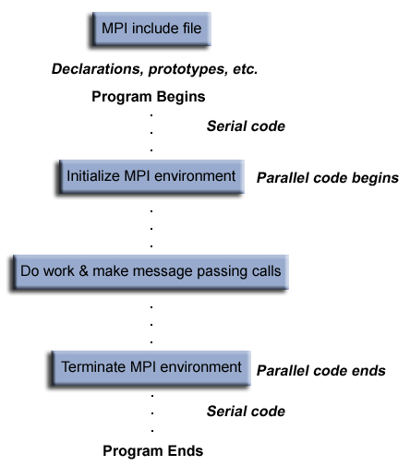
Program Structure

Slide 77

Communicators and Groups
MPI uses objects called communicators and groups to define which collection of processes may communicate with each other.
Most MPI routines require you to specify a communicator as an argument.

Slide 78
Initializing
MPI Init:
MPI_Init (&argc,&argv)
MPI_INIT (ierr)
MPI_Comm_size:
MPI_Comm_size (comm,&size)
MPI_COMM_SIZE (comm,size,ierr)
Determines the number of processes in the group associated with a communicator.
MPI_Comm_rank:
MPI_Comm_rank (comm,&rank)
MPI_COMM_RANK (comm,rank,ierr)
Determines the rank (task ID) of the calling process within the communicator. Value 0...p-1

Slide 79
Initializing
MPI_Abort:
MPI_Abort (comm,errorcode)
MPI_ABORT (comm,errorcode,ierr)
Terminates all MPI processes associated with the communicator.
MPI_Finalize:
MPI_Finalize ()
MPI_FINALIZE (ierr)
Terminates the MPI execution environment. This function should be the last MPI routine called in every MPI program - no other MPI routines may be called after it.

Slide 80
Example: C
#include <mpi.h>
#include <stdio.h>
int main(argc,argv)
int argc;
char *argv[]; {
int numtasks, rank, rc;
rc = MPI_Init(&argc,&argv);
if (rc != MPI_SUCCESS) {
printf ("Error starting MPI program. Terminating.\n");
MPI_Abort(MPI_COMM_WORLD, rc);
}
MPI_Comm_size(MPI_COMM_WORLD,&numtasks);
MPI_Comm_rank(MPI_COMM_WORLD,&rank);
printf ("Number of tasks= %d My rank= %d\n", numtasks,rank);
/******* do some work *******/
MPI_Finalize();
}

Slide 81
Example: F
program simple
include 'mpif.h'
integer numtasks, rank, ierr, rc
call MPI_INIT(ierr)
if (ierr .ne. MPI_SUCCESS) then
print *,'Error starting MPI program. Terminating.'
call MPI_ABORT(MPI_COMM_WORLD, rc, ierr)
end if
call MPI_COMM_RANK(MPI_COMM_WORLD, rank, ierr)
call MPI_COMM_SIZE(MPI_COMM_WORLD, numtasks, ierr)
print *, 'Number of tasks=',numtasks,' My rank=',rank
C ****** do some work ******
call MPI_FINALIZE(ierr)
end

Slide 82
Point to Point Communication
MPI point-to-point operations typically involve message passing between two, and only two, different MPI tasks. One task is performing a send operation and the other task is performing a matching receive operation.
Different types of send and receive routines:
Synchronous send
Blocking send / blocking receive
Non-blocking send / non-blocking receive
Buffered send
Combined send/receive
"Ready" send
Any type of send routine can be paired with any type of receive routine.

Slide 83
Exercise 1: Hello World
Based on the last example write a MPI version of hello world and run it on 4 cores. Each process should print “Hello World” and it's task number.
Hint:
You need the following MPI routines for this exercise:
MPI_Init (&argc,&argv)
MPI_Comm_rank (MPI_COMM_WORLD, &rank)
MPI_Comm_size (MPI_COMM_WORLD, &size)
MPI_Finalize()

Slide 84
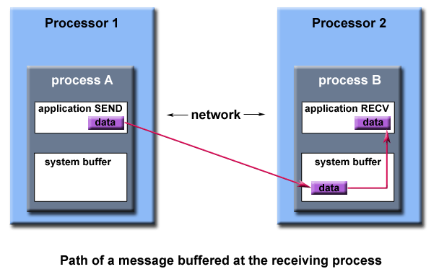
Buffering
In a perfect world, every send operation would be perfectly synchronized with its matching receive. This is rarely the case. The MPI implementation must be able to deal with storing data when the two tasks are out of sync.
Consider the following two cases:
- A send operation occurs 5 seconds before the receive is ready - where is the message while the receive is pending?
- Multiple sends arrive at the same receiving task which can only accept one send at a time - what happens to the messages that are "backing up"?
The MPI implementation (not the MPI standard) decides what happens to data in these types of cases. Typically, a system buffer area is reserved to hold data in transit. For example:

Slide 85
Blocking vs. Non-blocking
Blocking:
A blocking send routine will only "return" after it is safe to modify the application buffer (your send data) for reuse. Safe means that modifications will not affect the data intended for the receive task. Safe does not imply that the data was actually received - it may very well be sitting in a system buffer.
A blocking send can be synchronous which means there is handshaking occurring with the receive task to confirm a safe send.
A blocking send can be asynchronous if a system buffer is used to hold the data for eventual delivery to the receive.
A blocking receive only "returns" after the data has arrived and is ready for use by the program.
Non-blocking:
Non-blocking send and receive routines behave similarly - they will return almost immediately. They do not wait for any communication events to complete, such as message copying from user memory to system buffer space or the actual arrival of message.
Non-blocking operations simply "request" the MPI library to perform the operation when it is able. The user can not predict when that will happen.
It is unsafe to modify the application buffer (your variable space) until you know for a fact the requested non-blocking operation was actually performed by the library. There are "wait" routines used to do this.
Non-blocking communications are primarily used to overlap computation with communication and exploit possible performance gains.

Slide 86
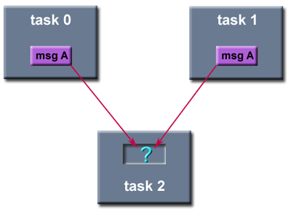
Order and Fairness
Order: MPI guarantees that messages will not overtake each other.
Fairness: MPI does not guarantee fairness - it's up to the programmer to prevent "operation starvation".
Example: task 0 sends a message to task 2. However, task 1 sends a competing message that matches task 2's receive. Only one of the sends will complete.

Slide 87
MPI Send / Receive
MPI point-to-point communication routines generally have an argument list that takes one of the following formats:
MPI_Send (&buf,count,datatype,dest,tag,comm)
MPI_SEND (buf,count,datatype,dest,tag,comm,ierr)
Buffer
Program (application) address space that references the data that is to be sent or received. In most cases, this is simply the variable name that is be sent/received. For C programs, this argument is passed by reference and usually must be prepended with an ampersand: &var1
Data Count
Indicates the number of data elements of a particular type to be sent.
Data Type
For reasons of portability, MPI predefines its elementary data types.
MPI_CHAR – signed char
MPI_INT – signed int
MPI_FLOAT – float
MPI_DOUBLE – double
You can also create your own derived data types.

Slide 88
MPI Send / Receive
Destination
An argument to send routines that indicates the process where a message should be delivered. Specified as the rank of the receiving process.
Source
An argument to receive routines that indicates the originating process of the message. Specified as the rank of the sending process. This may be set to the wild card MPI_ANY_SOURCE to receive a message from any task.
Tag
Arbitrary non-negative integer assigned by the programmer to uniquely identify a message. Send and receive operations should match message tags. For a receive operation, the wild card MPI_ANY_TAG can be used to receive any message regardless of its tag. The MPI standard guarantees that integers 0-32767 can be used as tags, but most implementations allow a much larger range than this.
Communicator
Indicates the communication context, or set of processes for which the source or destination fields are valid. Unless the programmer is explicitly creating new communicators, the predefined communicator MPI_COMM_WORLD is usually used.

Slide 89
MPI Send / Receive
Status
For a receive operation, indicates the source of the message and the tag of the message. In C, this argument is a pointer to a predefined structure MPI_Status (ex. stat.MPI_SOURCE stat.MPI_TAG). In Fortran, it is an integer array of size MPI_STATUS_SIZE (ex. stat(MPI_SOURCE) stat(MPI_TAG)). Additionally, the actual number of bytes received are obtainable from Status via the MPI_Get_count routine.
Request
Used by non-blocking send and receive operations. Since non-blocking operations may return before the requested system buffer space is obtained, the system issues a unique "request number". The programmer uses this system assigned "handle" later (in a WAIT type routine) to determine completion of the non-blocking operation. In C, this argument is a pointer to a predefined structure MPI_Request. In Fortran, it is an integer.

Slide 90
MPI Send / Receive
Blocking sends MPI_Send(buffer,count,type,dest,tag,comm)
Non-blocking sends MPI_Isend(buffer,count,type,dest,tag,comm,request)
Blocking receive MPI_Recv(buffer,count,type,source,tag,comm,status)
Non-blocking receive MPI_Irecv(buffer,count,type,source,tag,comm,request)
MPI_Send:Basic blocking send operation. Routine returns only after the application buffer in the sending task is free for reuse.
MPI_Send (&buf,count,datatype,dest,tag,comm)
MPI_SEND (buf,count,datatype,dest,tag,comm,ierr)
MPI_Recv (&buf,count,datatype,source,tag,comm,&status)
MPI_RECV (buf,count,datatype,source,tag,comm,status,ierr)
Synchronous blocking send:Send a message and block until the application buffer in the sending task is free for reuse and the destination process has started to receive the message.
MPI_Ssend (&buf,count,datatype,dest,tag,comm)
MPI_SSEND (buf,count,datatype,dest,tag,comm,ierr)
Buffered blocking send:permits the programmer to allocate the required amount of buffer space into which data can be copied until it is delivered. Insulates against the problems associated with insufficient system buffer space.
MPI_Bsend (&buf,count,datatype,dest,tag,comm)
MPI_BSEND (buf,count,datatype,dest,tag,comm,ierr)

Slide 91
Blocking Msg Passing Example: C
#include <mpi.h>
#include <stdio.h>
int main(argc,argv)
int argc;
char *argv[]; {
int numtasks, rank, dest, source, rc, count, tag=1;
char inmsg, outmsg='x';
MPI_Status Stat;
MPI_Init(&argc,&argv);
MPI_Comm_size(MPI_COMM_WORLD, &numtasks);
MPI_Comm_rank(MPI_COMM_WORLD, &rank);
if (rank == 0) {
dest = 1;
source = 1;
rc = MPI_Send(&outmsg, 1, MPI_CHAR, dest, tag, MPI_COMM_WORLD);
rc = MPI_Recv(&inmsg, 1, MPI_CHAR, source, tag, MPI_COMM_WORLD, &Stat);
}
else if (rank == 1) {
dest = 0;
source = 0;
rc = MPI_Recv(&inmsg, 1, MPI_CHAR, source, tag, MPI_COMM_WORLD, &Stat);
rc = MPI_Send(&outmsg, 1, MPI_CHAR, dest, tag, MPI_COMM_WORLD);
}
rc = MPI_Get_count(&Stat, MPI_CHAR, &count);
printf("Task %d: Received %d char(s) from task %d with tag %d \n",
rank, count, Stat.MPI_SOURCE, Stat.MPI_TAG);
MPI_Finalize();
}

Slide 92
Blocking Msg Passing Example: F
program ping
include 'mpif.h'
integer numtasks, rank, dest, source, count, tag, ierr
integer stat(MPI_STATUS_SIZE)
character inmsg, outmsg
outmsg = 'x'
tag = 1
call MPI_INIT(ierr)
call MPI_COMM_RANK(MPI_COMM_WORLD, rank, ierr)
call MPI_COMM_SIZE(MPI_COMM_WORLD, numtasks, ierr)
if (rank .eq. 0) then
dest = 1
source = 1
call MPI_SEND(outmsg, 1, MPI_CHARACTER, dest, tag,
& MPI_COMM_WORLD, ierr)
call MPI_RECV(inmsg, 1, MPI_CHARACTER, source, tag,
& MPI_COMM_WORLD, stat, ierr)
else if (rank .eq. 1) then
dest = 0
source = 0
call MPI_RECV(inmsg, 1, MPI_CHARACTER, source, tag,
& MPI_COMM_WORLD, stat, err)
call MPI_SEND(outmsg, 1, MPI_CHARACTER, dest, tag,
& MPI_COMM_WORLD, err)
endif
call MPI_GET_COUNT(stat, MPI_CHARACTER, count, ierr)
print *, 'Task ',rank,': Received', count, 'char(s) from task',
& stat(MPI_SOURCE), 'with tag',stat(MPI_TAG)
call MPI_FINALIZE(ierr)
end

Slide 93
Exercise 2: Ping
Write a MPI program which sends a message to another process which receives it and sends it back. For this you need 2 processes. Test whether the program was invoked with more than 2 processes and display a warning that the program will only use 2 processes.
Run the program with:
mpirun -np 2 ./ping

Slide 94
Non-Blocking Msg Passing
MPI_Isend
Identifies an area in memory to serve as a send buffer. Processing continues immediately without waiting for the message to be copied out from the application buffer. A communication request handle is returned for handling the pending message status. The program should not modify the application buffer until subsequent calls to MPI_Wait or MPI_Test indicate that the non-blocking send has completed.
MPI_Irecv
Identifies an area in memory to serve as a receive buffer. Processing continues immediately without actually waiting for the message to be received and copied into the the application buffer. A communication request handle is returned for handling the pending message status. The program must use calls to MPI_Wait or MPI_Test to determine when the non-blocking receive operation completes and the requested message is available in the application buffer.
MPI_Issend
Non-blocking synchronous send. Similar to MPI_Isend(), except MPI_Wait() or MPI_Test() indicates when the destination process has received the message.
MPI_Ibsend
Non-blocking buffered send. Similar to MPI_Bsend() except MPI_Wait() or MPI_Test() indicates when the destination process has received the message. Must be used with the MPI_Buffer_attach routine.
MPI_Irsend
Non-blocking ready send. Similar to MPI_Rsend() except MPI_Wait() or MPI_Test() indicates when the destination process has received the message. Should only be used if the programmer is certain that the matching receive has already been posted.

Slide 95
Non-Blocking Msg Passing: C
#include <mpi.h> /* Nearest neighbor exchange in ring topology */
#include <stdio.h>
int main(argc,argv)
int argc;
char *argv[]; {
int numtasks, rank, next, prev, buf[2], tag1=1, tag2=2;
MPI_Request reqs[4];
MPI_Status stats[2];
MPI_Init(&argc,&argv);
MPI_Comm_size(MPI_COMM_WORLD, &numtasks);
MPI_Comm_rank(MPI_COMM_WORLD, &rank);
prev = rank-1;
next = rank+1;
if (rank == 0) prev = numtasks - 1;
if (rank == (numtasks - 1)) next = 0;
MPI_Irecv(&buf[0], 1, MPI_INT, prev, tag1, MPI_COMM_WORLD, &reqs[0]);
MPI_Irecv(&buf[1], 1, MPI_INT, next, tag2, MPI_COMM_WORLD, &reqs[1]);
MPI_Isend(&rank, 1, MPI_INT, prev, tag2, MPI_COMM_WORLD, &reqs[2]);
MPI_Isend(&rank, 1, MPI_INT, next, tag1, MPI_COMM_WORLD, &reqs[3]);
{ do some work }
MPI_Waitall(4, reqs, stats);
MPI_Finalize();
}

Slide 96
Non-Blocking Msg Passing: F
program ringtopo
include 'mpif.h'
integer numtasks, rank, next, prev, buf(2), tag1, tag2, ierr
integer stats(MPI_STATUS_SIZE,2), reqs(4)
tag1 = 1
tag2 = 2
call MPI_INIT(ierr)
call MPI_COMM_RANK(MPI_COMM_WORLD, rank, ierr)
call MPI_COMM_SIZE(MPI_COMM_WORLD, numtasks, ierr)
prev = rank - 1
next = rank + 1
if (rank .eq. 0) then
prev = numtasks - 1
endif
if (rank .eq. numtasks - 1) then
next = 0
endif
call MPI_IRECV(buf(1), 1, MPI_INTEGER, prev, tag1,
& MPI_COMM_WORLD, reqs(1), ierr)
call MPI_IRECV(buf(2), 1, MPI_INTEGER, next, tag2,
& MPI_COMM_WORLD, reqs(2), ierr)
call MPI_ISEND(rank, 1, MPI_INTEGER, prev, tag2,
& MPI_COMM_WORLD, reqs(3), ierr)
call MPI_ISEND(rank, 1, MPI_INTEGER, next, tag1,
& MPI_COMM_WORLD, reqs(4), ierr)
C do some work
call MPI_WAITALL(4, reqs, stats, ierr);
call MPI_FINALIZE(ierr)
end

Slide 97
Collective Communication Routines
MPI_Barrier
Creates a barrier synchronization in a group. Each task, when reaching the MPI_Barrier call, blocks until all tasks in the group reach the same MPI_Barrier call.
MPI_Barrier (comm)
MPI_BARRIER (comm,ierr)
MPI_Bcast
Broadcasts (sends) a message from the process with rank "root" to all other processes in the group.
MPI_Bcast (&buffer,count,datatype,root,comm)
MPI_BCAST (buffer,count,datatype,root,comm,ierr)
MPI_Scatter
Distributes distinct messages from a single source task to each task in the group.
MPI_Scatter (&sendbuf,sendcnt,sendtype,&recvbuf,
...... recvcnt,recvtype,root,comm)
MPI_SCATTER (sendbuf,sendcnt,sendtype,recvbuf,
...... recvcnt,recvtype,root,comm,ierr)
MPI_Gather
Gathers distinct messages from each task in the group to a single destination task. This routine is the reverse operation of MPI_Scatter.
MPI_Gather (&sendbuf,sendcnt,sendtype,&recvbuf,
...... recvcount,recvtype,root,comm)
MPI_GATHER (sendbuf,sendcnt,sendtype,recvbuf,
...... recvcount,recvtype,root,comm,ierr)
MPI_Reduce
Applies a reduction operation on all tasks in the group and places the result in one task.
MPI_Reduce (&sendbuf,&recvbuf,count,datatype,op,root,comm)
MPI_REDUCE (sendbuf,recvbuf,count,datatype,op,root,comm,ierr)

Slide 98
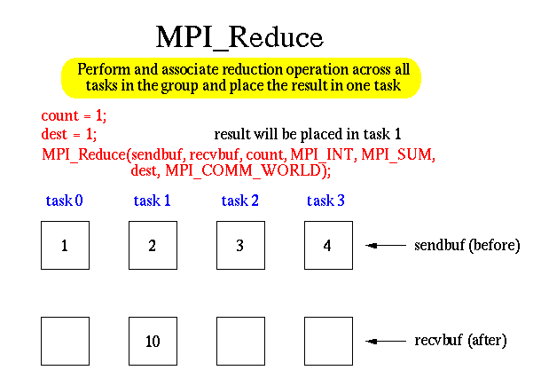
Collective Communication Routines
MPI_Reduce
Applies a reduction operation on all tasks in the group and places the result in one task.
MPI_Reduce (&sendbuf,&recvbuf,count,datatype,op,root,comm)
MPI_REDUCE (sendbuf,recvbuf,count,datatype,op,root,comm,ierr)
Predefined operations are:
MPI_MAX
MPI_MIN
MPI_SUM
MPI_PROD
etc
Users can also define their own reduction functions by using the MPI_Op_create routine.

Slide 99
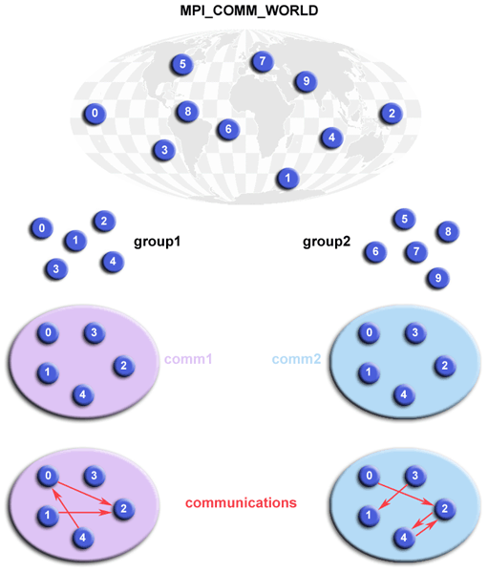
Communicator Groups
A group is an ordered set of processes. Each process in a group is associated with a unique integer rank.
Allow you to organize tasks, based upon function, into task groups.
Provide basis for implementing user defined virtual topologies
Provide for safe communications
Groups/communicators are dynamic - they can be created and destroyed during program execution.
MPI has over 40 routines related to groups, communicators, and virtual topologies.

Slide 100
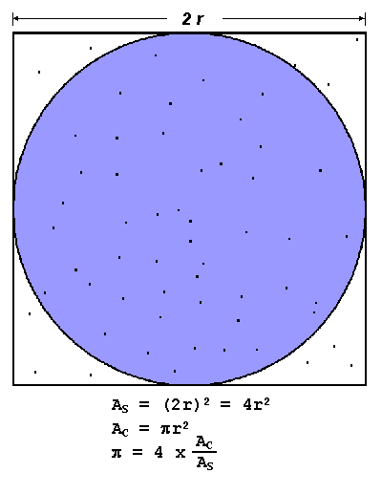
Exercise 3: Pi
Write a MPI program which calculates pi using a Monte Carlo method.
Hints:
Serial pseudo code:
npoints = 10000
circle_count = 0
do j = 1,npoints
generate 2 random numbers between 0 and 1
xcoordinate = random1
ycoordinate = random2
if (xcoordinate, ycoordinate) inside circle
then circle_count = circle_count + 1
end do
PI = 4.0*circle_count/npoints

Slide 101
Exercise 3: Pi (continued)
Parallel pseudo code:
npoints = 10000
circle_count = 0
p = number of tasks
num = npoints/p
find out if I am MASTER or WORKER
do j = 1,num
generate 2 random numbers between 0 and 1
xcoordinate = random1
ycoordinate = random2
if (xcoordinate, ycoordinate) inside circle
then circle_count = circle_count + 1
end do
if I am MASTER
receive from WORKERS their circle_counts
compute PI (use MASTER and WORKER calculations)
else if I am WORKER
send to MASTER circle_count
Endif
Hint: Use rc = MPI_Reduce(&homepi, &pisum, 1, MPI_DOUBLE, MPI_SUM,
MASTER, MPI_COMM_WORLD);

Slide 102
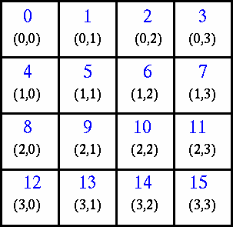
Virtual Topologies
In terms of MPI, a virtual topology describes a mapping/ordering of MPI processes into a geometric "shape" such as Graphs or Cartesian Grids.
They are virtual: no relation to the underlying hardware.
They are build on communicators and groups.
Example: A simplified mapping of processes into a Cartesian virtual topology:

Slide 103
MPI-2
Dynamic Processes - extensions that remove the static process model of MPI. Provides routines to create new processes.
One-Sided Communications - provides routines for one directional communications. Include shared memory operations (put/get) and remote accumulate operations.
Extended Collective Operations - allows for non-blocking collective operations and application of collective operations to inter-communicators
External Interfaces - defines routines that allow developers to layer on top of MPI, such as for debuggers and profilers.
Additional Language Bindings - describes C++ bindings and discusses Fortran-90 issues.
Parallel I/O - describes MPI support for parallel I/O.

Slide 104
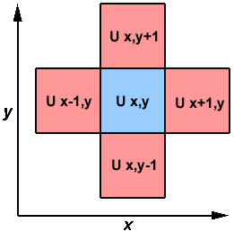

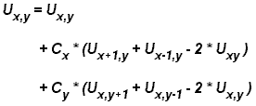
Homework
Write a MPI program to solve the Heat equation.
Write a MPI program to solve the Heat equation.
A serial program would look like:
do iy = 2, ny - 1
do ix = 2, nx - 1
u2(ix, iy) =
u1(ix, iy) +
cx * (u1(ix+1,iy) + u1(ix-1,iy) - 2.*u1(ix,iy)) +
cy * (u1(ix,iy+1) + u1(ix,iy-1) - 2.*u1(ix,iy))
end do
end do

Slide 105
Homework (cont)
Parallel Code as an SPMD model:
find out if I am MASTER or WORKER
if I am MASTER
initialize array
send each WORKER starting info and subarray
receive results from each WORKER
else if I am WORKER
receive from MASTER starting info and subarray
do t = 1, nsteps
update time
send neighbors my border info
receive from neighbors their border info
update my portion of solution array
end do
send MASTER results
endif

Slide 106
Conclusions / Implementations
Advantages / Disadvantages:
- Can scale very nicely up to thousands of cores
- Difficult to program and to debug
- The whole program have to be designed for MPI
Different MPI implementations:
- MPICH, MPICH2
- MVAPICH
- OpenMPI
- SGI MPT
Don't mix MPI/compiler combinations!

Slide 107
Getting Help
Website: Intersect and NCI
Email: hpc_support@intersect.org.au
help@nf.nci.org.au
Courses:
-Introduction into Linux
-Introduction to HPC@Intersect
-Parallel Programming: OpenMP and MPI
-Programming in Fortran 90 (planned)

Slide 108
Acknowledgment
Blaise Barney, Lawrence Livermore National Laboratory
www.llnl.gov

Slide 109
Thanks for attending!
Please complete our course survey at:
http://svy.mk/18c8dHa
Any further questions, contact us at
training@intersect.org.au
Find out about upcoming courses by signing up to our mailing list
http://bit.ly/1aZvRqw

Slide 110
Thank you for your attention!

